Slide 1
Leptospirosis
Assist. Prof. Dr. Hussein ALNaji

Slide 2
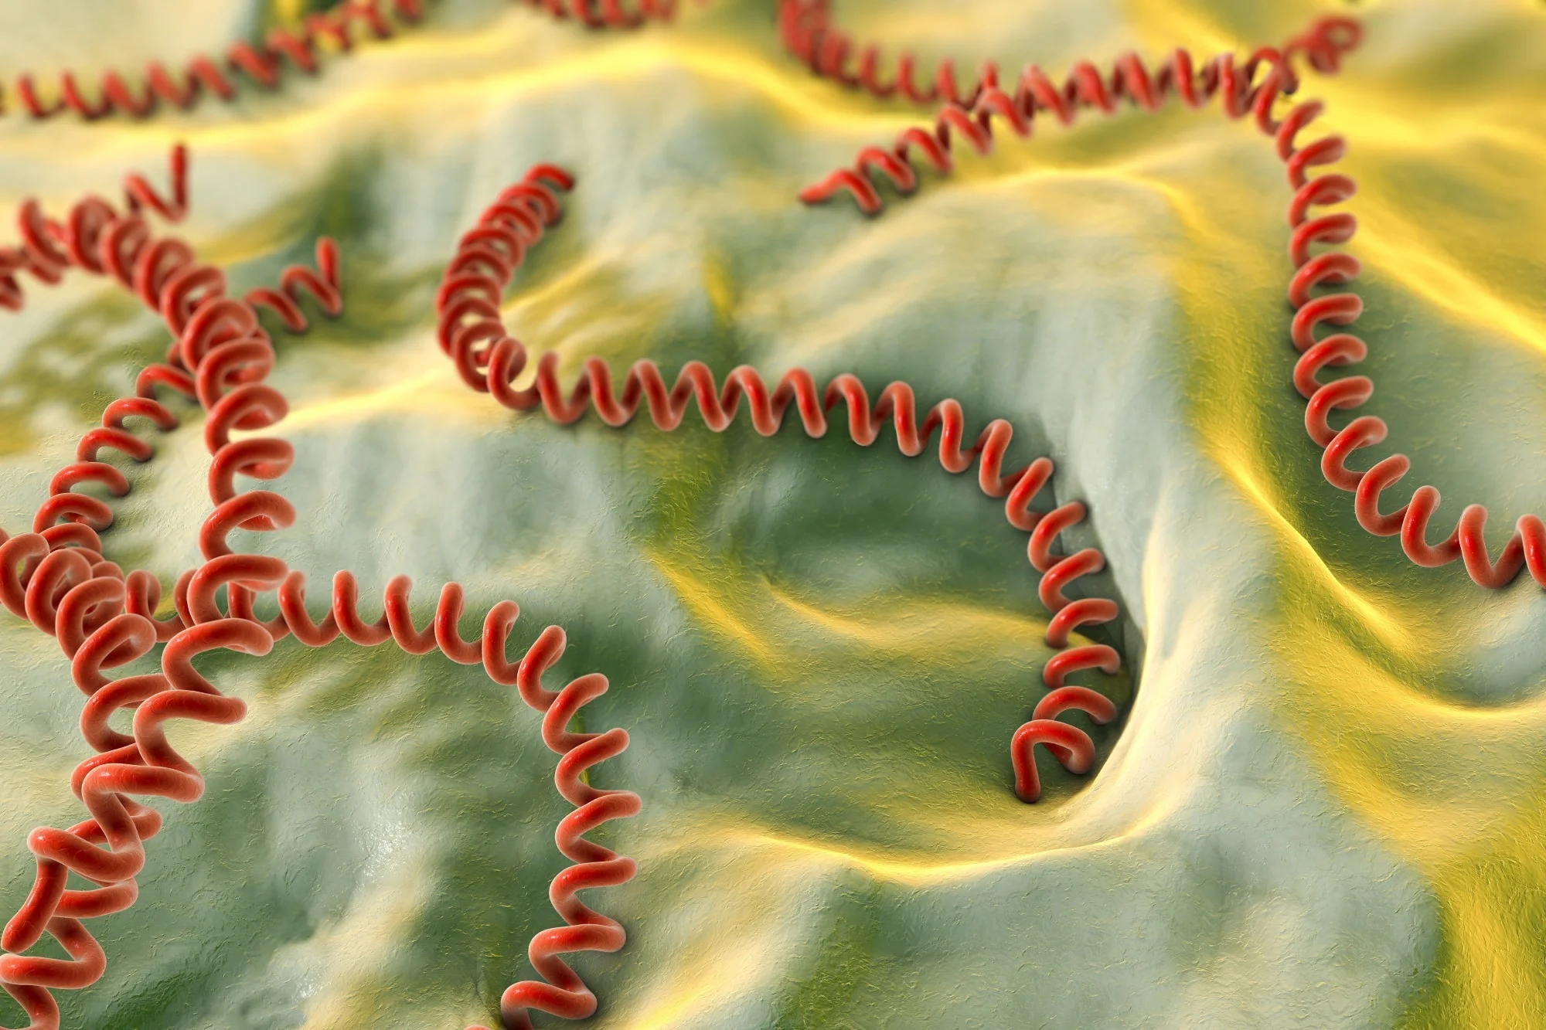
Leptospirosis is an infectious disease of humans and animals that is caused by pathogenic spirochetes of the genus Leptospira (Leptospira interrogans). It is considered the most common zoonosis in the world. Leptospirosis is distributed worldwide (sparing the polar regions) but is most common in the tropics. Leptospira species infect a wide range of animals, including mammals, birds, amphibians, and reptiles. Part of its life cycle is a chronic carrier state in some animals, in which the leptospires spread hematogenously, colonize the proximal renal tubules, and are shed via urine into the environment.

Slide 3
Transmission and spread
1- The bacteria can be found in ponds, rivers, puddles, sewers, agricultural fields and moist soil.
2- Rats, mice, and moles are important primary hosts, but other mammals including dogs, deer, and other animals also carry the disease.
3- Humans are the accidental host of Leptospira. Humans become infected through contact with water or moist soil that contains urine & feces from infected animals.
4- The bacteria enter through cuts, abrasions, ingestion of contaminated food, or contact with mucous membrane of the body (e.g. mouth, nose, and eyes).
5- The disease is not known to spread between humans.

Slide 5
Symptoms of Anthrax
Weil's disease the acute, severe form of leptospirosis, causes the infected individual to become jaundiced (skin and eyes become yellow), develop kidney failure, and bleed. Bleeding from the lungs associated with leptospirosis is known as severe pulmonary haemorrhage syndrome

Slide 6
Diagnosis
1- Diagnosis is usually based on serology in conjunction with the clinical presentation and epidemiological data (a history of possible exposure, presence of risk factors).
2- The microscopic agglutination test (MAT) .
3- The enzyme linked immunosorbent assay (ELISA).
4- Isolation of leptospires from blood, urine or other clinical materials through culture.
5- Detection by polymerase chain reaction (PCR) .
6- Immune staining techniques may be available in some centers.

Slide 7
Prevention
1- Vaccinating animals is an important step in preventing leptospirosis, but there is no vaccine for humans.
2-Avoid flood water and any other water you think might be contaminated.
3- Wear protective clothing such as shoes, gloves, goggles, when working with animals, or working in water, soil or mud.
4- Cover any cuts and abrasions on your skin with a waterproof dressing.
5-Always wash and dry your hands, to prevent infection spreading.
6- Shower after working in mud, soil, water or with animals you think might be infected.

Slide 8
Thank you

